Slide 1
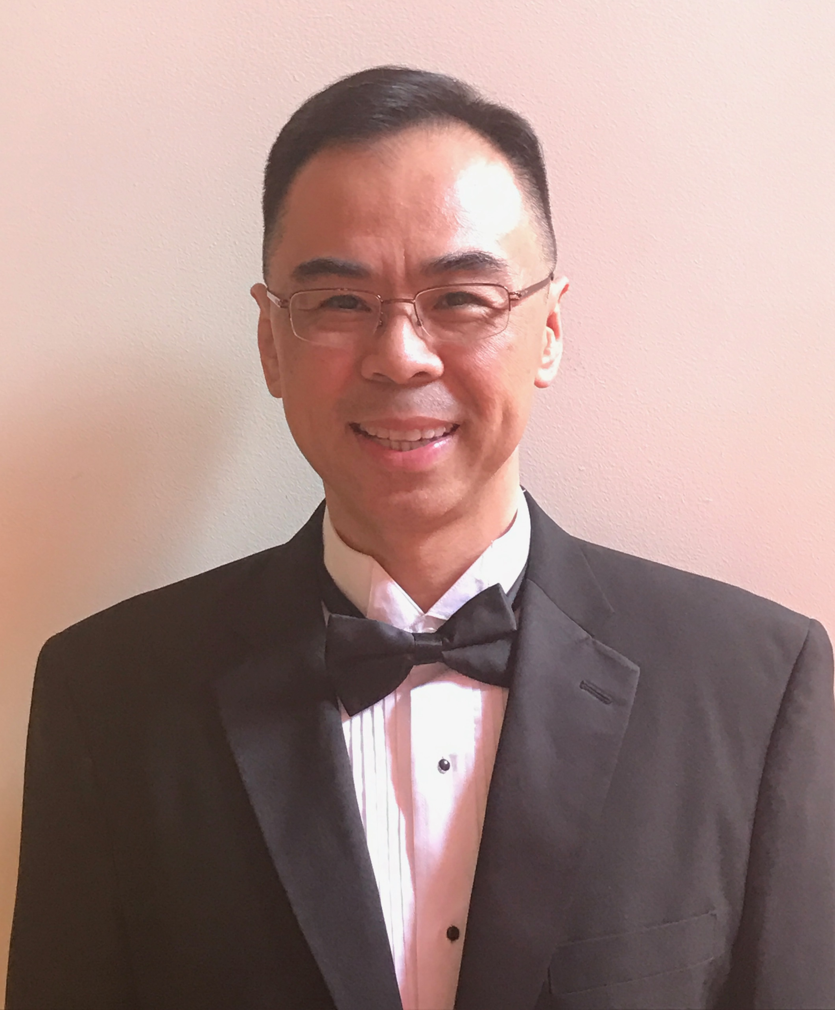
Welcome to ITEC 2150 – 01 Programming Fundamentals Summer 2022
Dr. Yan Z. Ding
Notes:
Hello and welcome to ITEC 1001 – Introduction to computing. This video will introduce you to the main components of the course and will show you how to get started.

Slide 2
Course Information
Class Time: TR 2:00 – 5:30 p.m.
Class Location: C 2130

Slide 3
Instructor Information
Instructor: Yan Z. Ding
Phone: 404-734-1482
Email: yding@ggc.edu

Slide 4
More about Your Instructor
Came from Shanghai, China in 1986
Attended Brookline High School (Brookline, MA) 1986 – 1988
B.A. in Pure Math from Brandeis University in 1992
M.S. in Computer Science from Harvard University in 1994
Research Scientist at BBN from 1994 – 1998
Ph.D. in Computer Science from Harvard in 2001
Taught CS @ Georgia Tech from 2001 – 2008
Joined GGC in 2008

Slide 5
This course
A continuation of ITEC 2140
Covers further concepts, principles & techniques of programming
See syllabus for the course outcome goals, topics and a tentative schedule

Slide 6
Required Course Resources
Free Online Textbook: Intermediate Programming http://itec2150.gitlab.io
Coding Assignment Site: https://class.mimir.io
Course Code: 6bfd124c1d

Slide 7
Supplementary Text
Introduction to Java Programming and Data Structures, 12th Ed.
Author: Y. Daniel Liang
Publisher: Pearson
ISBN: 978-0-13-562023-8
Electronic copy available on D2L

Slide 8
Integrated Development Environment
You need an IDE for Java
I recommend IntelliJ
https://www.jetbrains.com/idea/
You can download the Ultimate version of the product by creating an account using your GGC email

Slide 9
Grading
Grading Categories | Weight
Assignments | 50%
Midterm Exam | 15%
Final Exam | 35%
Assignments include
Class Assignments (~ 15)
Homework Assignments (~ 5)

Slide 10
Assignment Policies
Most assignments are to be submitted on Mimir and some on D2L
Assignments submitted via e-mail will not receive credit
Late assignments will not be accepted
However, if you need more time on an assignment and let me know in advance, I may give an extension to all students

Slide 11
Collaboration & Academic Honesty
You are allowed to collaborate for assignments
However, collaboration is limited to discussion of ideas only, and you must write your code on your own
Submission of code written by another person will result in an academic integrity violation!

Slide 12
Questions?
For questions, email me at yding@ggc.edu, or text me at 404-734-1482
I look forward to a wonderful
semester with you!

